Slide 1
Operators in Python
- Kavita Tewani

Slide 2
Basic Operators
Arithmetic Operators
Comparison (Relational) Operators
Assignment Operators
Logical Operators
Bitwise Operators
Membership Operators
Identity Operators

Slide 3
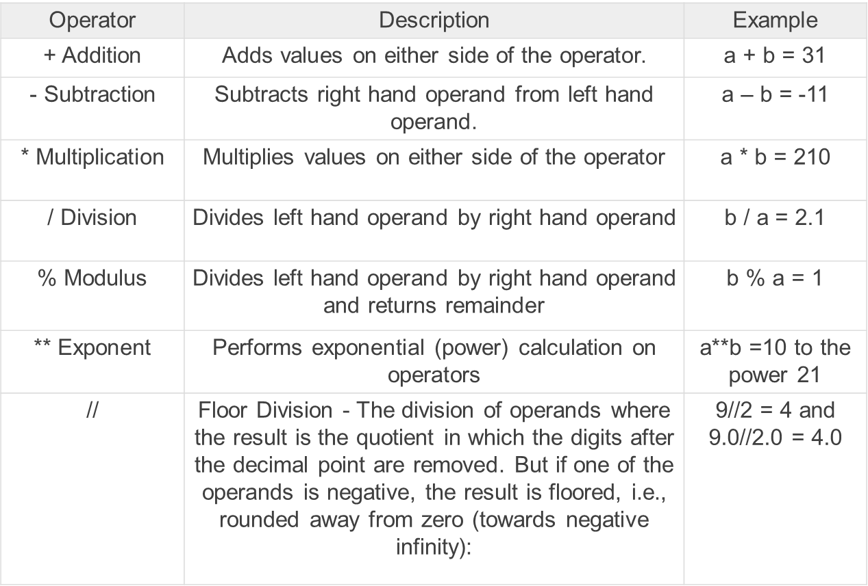
Arithmetic Operators
Assume variable a holds 10 and variable b holds 21, then

Slide 4
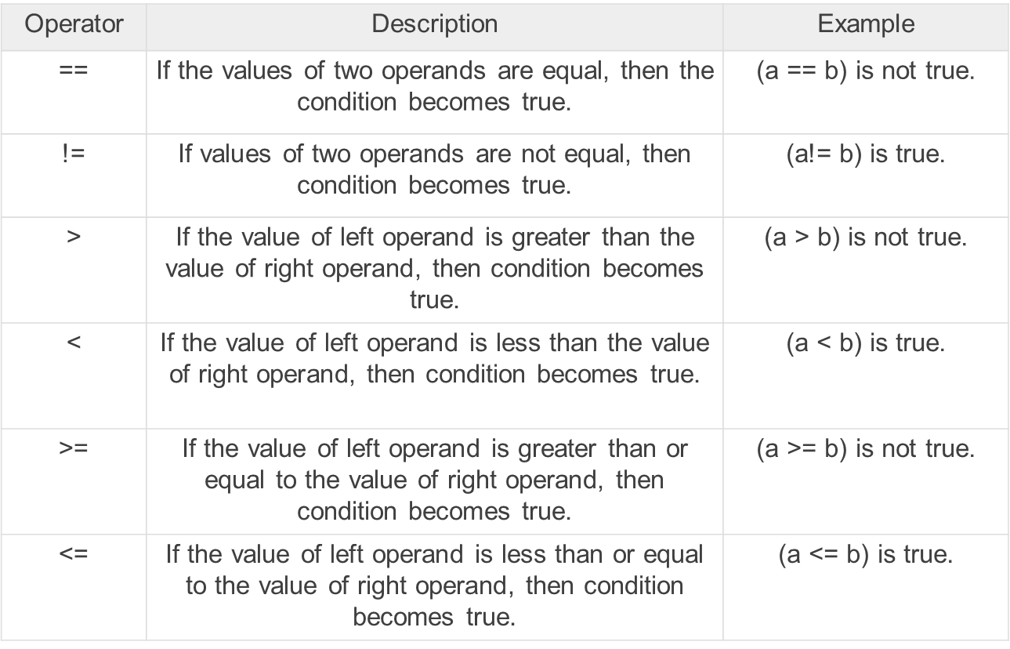
Comparison Operators
Assume variable a holds 10 and variable b holds 20, then

Slide 5
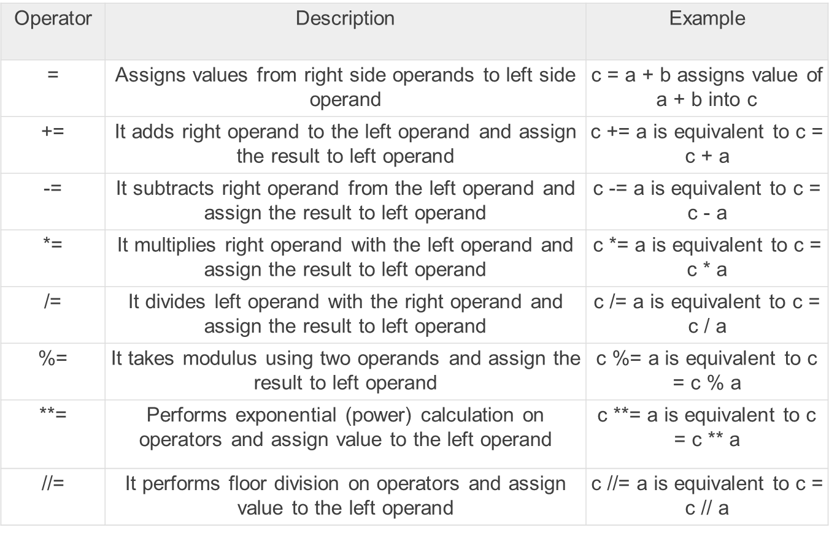
Assignment Operators
Assume variable a holds 10 and variable b holds 20, then

Slide 6
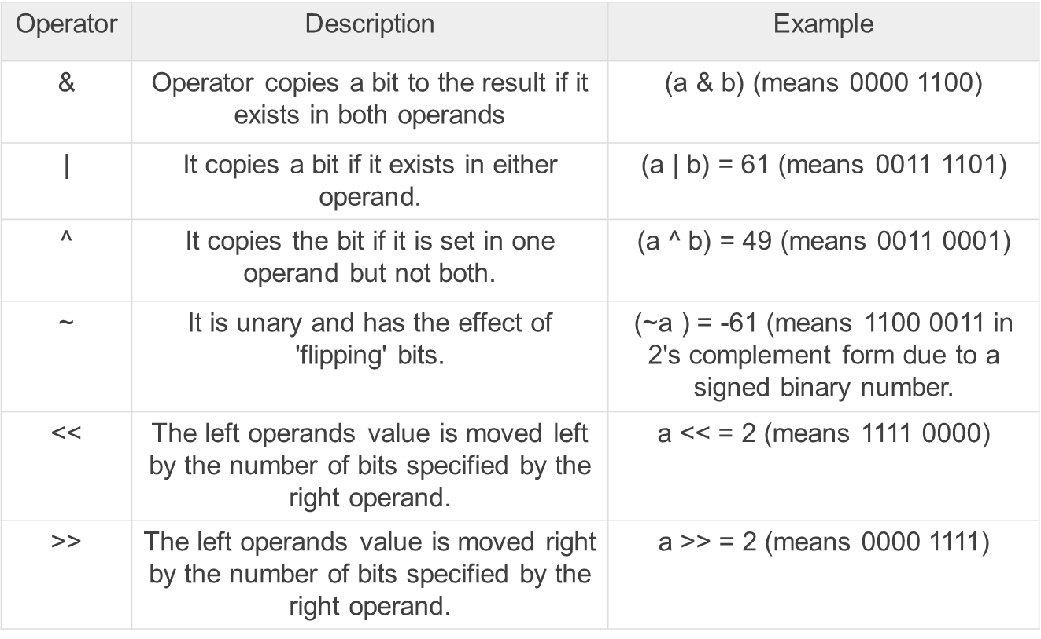
Bitwise Operators
Assume a = 60 = 0b00111100 and b = 13 = 0b00001101, then

Slide 7
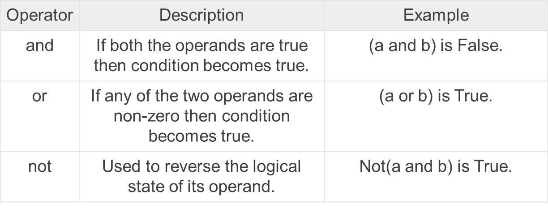
Logical Operators
Assume a = True (Case Sensitive) and b = False (Case Sensitive), then

Slide 8
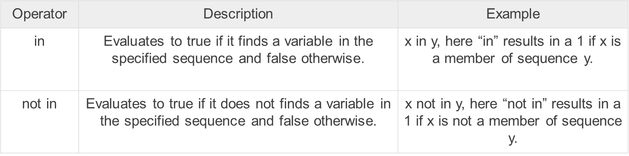
Membership Operators
Python’s membership operators test for membership in a sequence, such as strings, lists, or tuples.
There are two membership operators as explained below

Slide 9
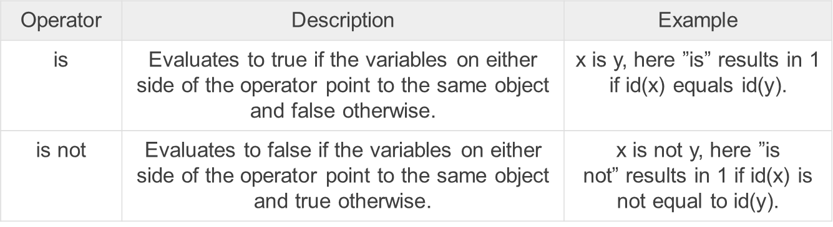
Identity Operators
Identity operators compare the memory locations of two objects.
There are two Identity operators explained below:

Slide 10
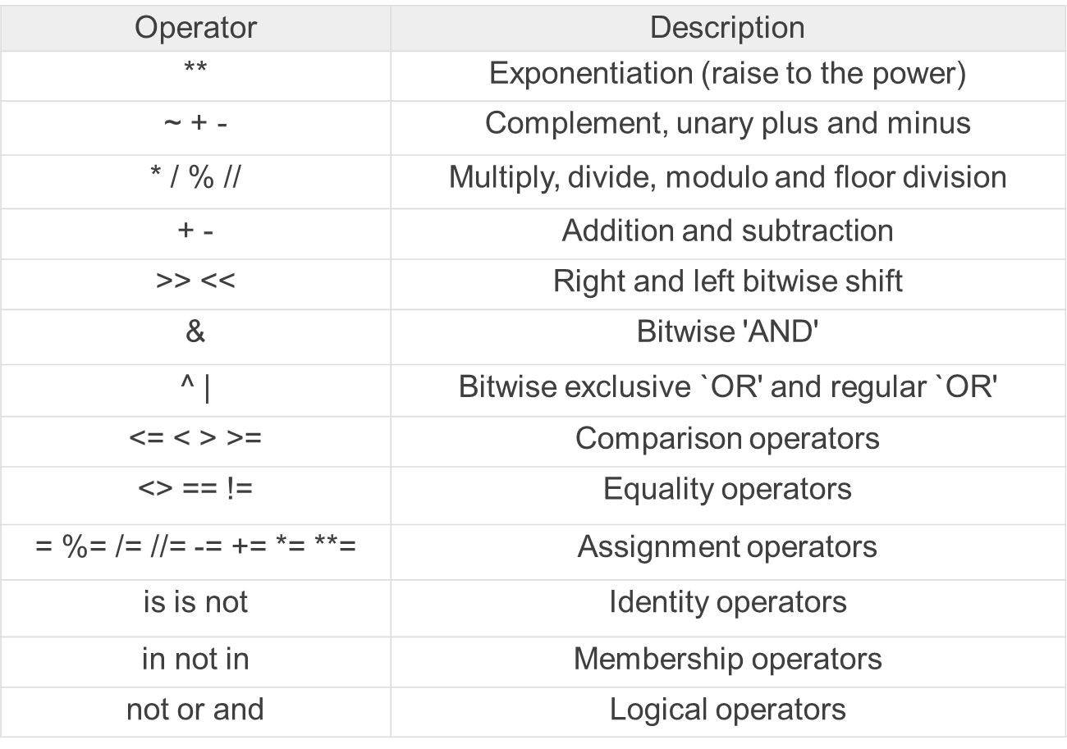
Python Operator Precedence

